Slide 1
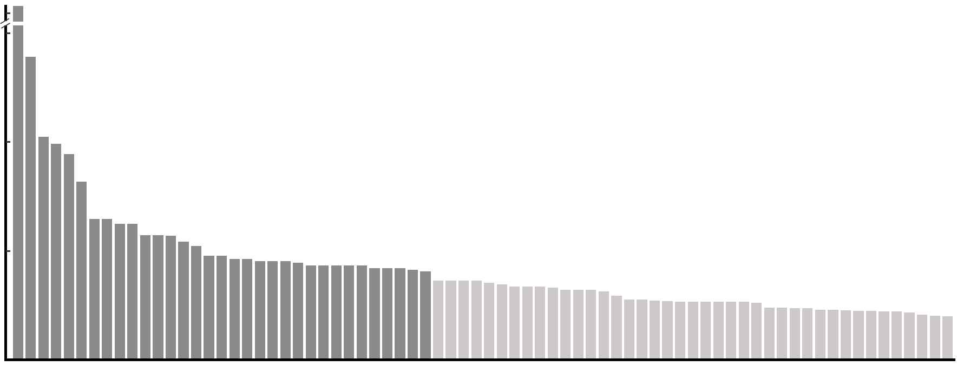
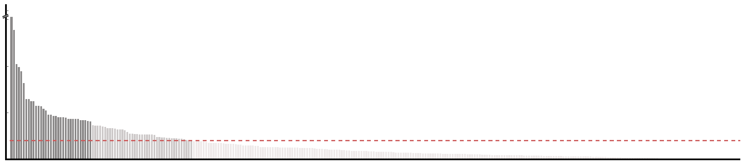
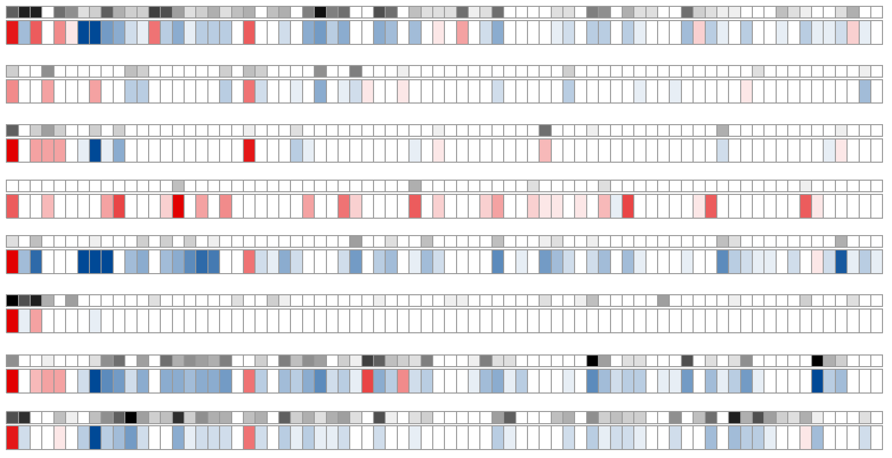
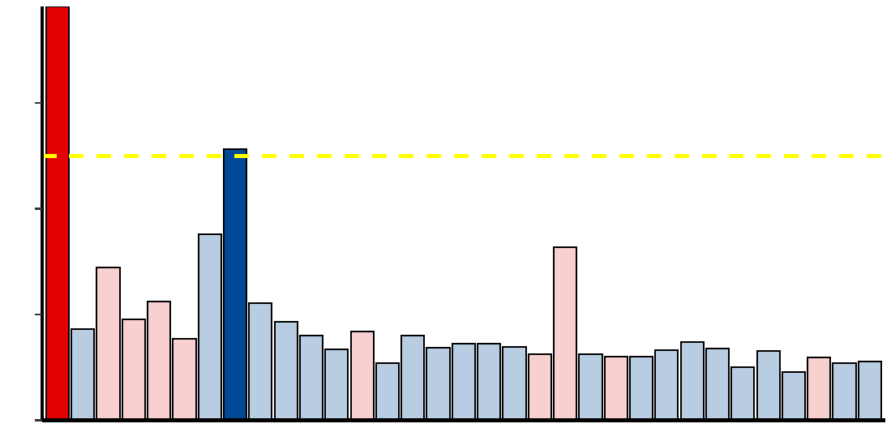
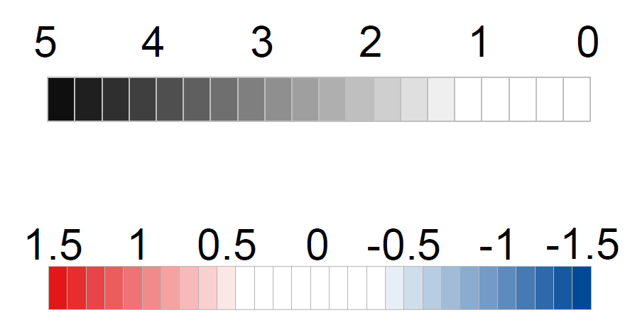
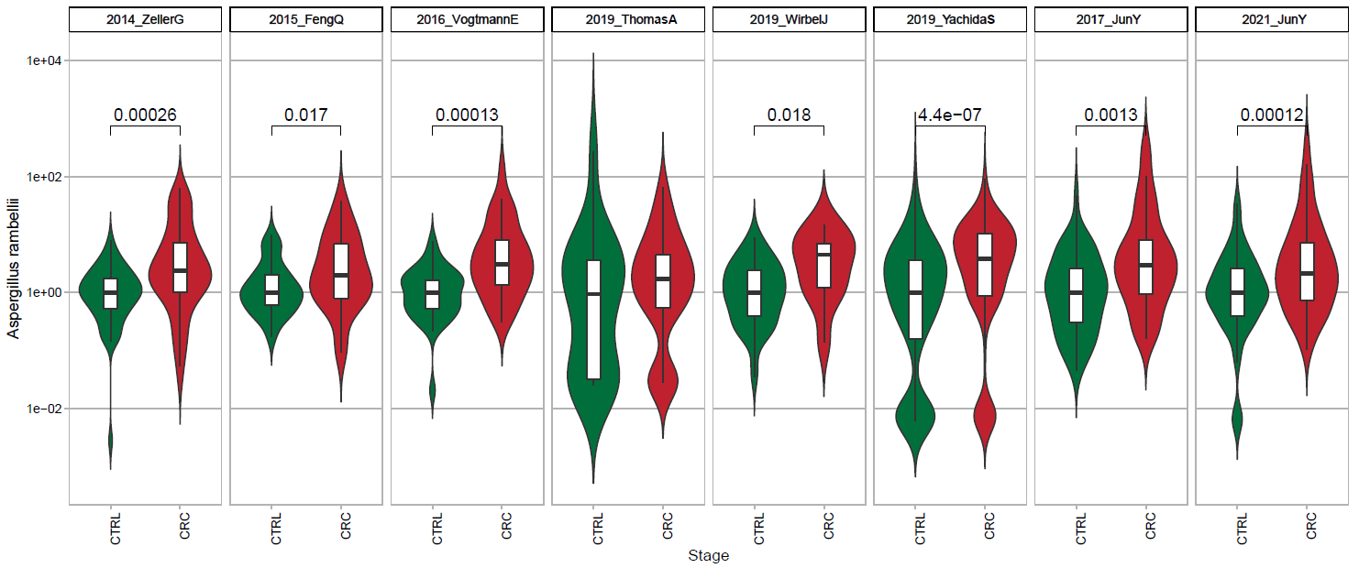
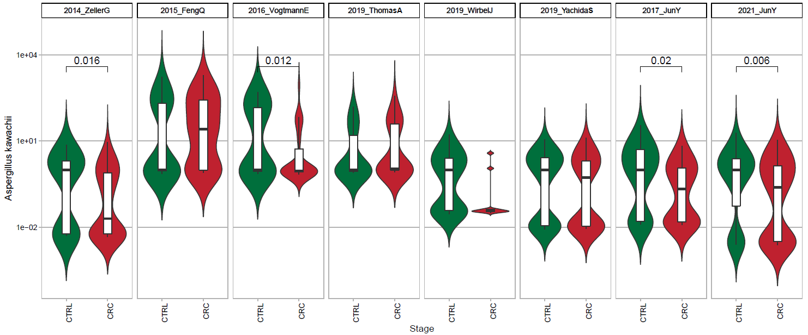

Figure 3
a
17.0
Fungal features selection
(control vs. CRC)
7.5
17.0
- log₁₀ FDR
7.5
- log₁₀ FDR
5.0
5.0
2.5
FDR < 0.1
2.5
0.0
FDR < 0.01
0.0
Aspergillus rambellii
Rhizophagus irregularis
Moniliophthora perniciosa
Erysiphe pulchra
Sphaerulina musiva
Phytophthora capsici
Trichophyton mentagrophytes
Aspergillus kawachii
Pneumocystis murina
Debaryomyces hansenii
Trichoderma atroviride
Pseudocercospora musae
Cordyceps sp. RAO−2017
Rhizophagus clarus
Pichia kudriavzevii
Paracoccidioides brasiliensis
Albugo candida
Lipomyces starkeyi
Naumovozyma dairenensis
Phytopythium vexans
Aspergillus ochraceoroseus
Colletotrichum fioriniae
Coniochaeta ligniaria
Leucoagaricus sp. SymC.cos
Colletotrichum salicis
[Candida] arabinofermentans
Baudoinia panamericana
Hyaloscypha variabilis
Schizosaccharomyces pombe
Tuber magnatum
Thielaviopsis punctulata
Edhazardia aedis
Choanephora cucurbitarum
Elsinoe australis
Piromyces sp. E2
Mucor circinelloides
Amorphotheca resinae
Colletotrichum tofieldiae
Sporisorium reilianum
Periconia macrospinosa
Blastomyces gilchristii
Cyberlindnera fabianii
Rhizoctonia solani
Spizellomyces punctatus
Pseudocercospora eumusae
Blumeria graminis
Pseudocercospora fijiensis
Aureobasidium namibiae
Calocera cornea
Polytolypa hystricis
Rhizopus delemar
Pythium aphanidermatum
Rozella allomycis
Batrachochytrium salamandrivorans
Rhizoclosmatium globosum
Cercospora zeina
Aspergillus steynii
Pezoloma ericae
Cordyceps fumosorosea
Pneumocystis carinii
Phialocephala subalpina
Moniliophthora roreri
Hanseniaspora valbyensis
Syncephalastrum racemosum
Histoplasma capsulatum
Tuber borchii
Phycomyces blakesleeanus
Saitoella complicata
Saccharomyces cerevisiae
Aspergillus udagawae
Candida maltosa
Rhodotorula graminis
Rutstroemia sp. NJR−2017a WRK4
Tolypocladium paradoxum
b
2014_ZellerG
(EU)
2015_FengQ
(OC)
2016_VogtmannE
(NA)
2019_ThomasAM
(EU)
2019_WirbelJ
(EU)
2019_YachidaS
(AS)
2017_YuJ
(AS)
2021_ YuJ
(AS)
c
abs( log₂ FC )
Aspergillus rambellii
- log₁₀(p value)
1.2
Aspergillus kawachii
abs( log₂ FC ) > 1.0
0.8
log₂(Fold change)
0.4
0.0
CRC Enriched
CRC Depleted
d
Aspergillus rambellii
Aspergillus kawachii
2014_ZellerG (EU)
2015_FengQ (OC)
2016_VogtmannE (NA)
2019_ThomasAM (EU)
2019_WirbelJ (EU)
2019_YachidaS (AS)
2017_ YuJ (AS)
2021_ YuJ (AS)
2014_ZellerG (EU)
2015_FengQ (OC)
2016_VogtmannE (NA)
2019_ThomasAM (EU)
2019_WirbelJ (EU)
2019_YachidaS (AS)
2017_ YuJ (AS)
2021_ YuJ (AS)

